Slide 1
SI 501 F21: Week 5 Agenda
Sample interview
Interpretation sessions
Interview protocol exchange
These slides are available in Canvas / Files.
There are links in these slides that will be helpful during this Lecture,
so please download a copy now.

Slide 2
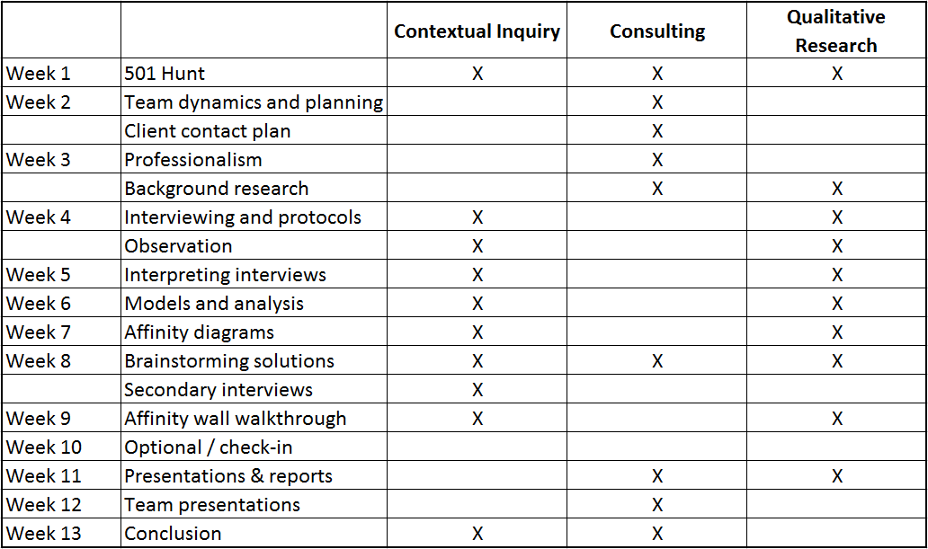
Course Overview

Slide 3
Example Interview
Overarching question: How do SI 501 students feel about the reading quizzes, and do they think there are ways that the goals of the quizzes could be accomplished in a better way?
[Warm up]
How many quizzes have you taken so far in SI 501?
How do you like the quizzes so far?
How do they work? I understand you do readings to prepare for them. Is that right?
[Prepping for quiz]
I’d like you to think back to the most recent quiz you took, and actually to your preparation for them. Can you tell me how you prepared for the most recent quiz?
[Follow up, if they don’t include in their response]
(I understand that most students are very busy.) When did you start your readings?
Where did you do your readings? At home? At the library? Somewhere else?
Did you take notes, and if so what kind of notes did you take?
Wow, you actually did X? Why / how do you do that?
Did you work with a classmate? Did you quiz each other?
Would you say that what you told me applies more generally to how you prepared for the other quizzes?
[Quiz time]
Again, thinking back to the most recent quiz, how did you feel when you actually took the quiz?
If it was hard, what made it hard?
What do you think of the multiple-choice nature of the quiz?
Do you think the questions are fair overall?
[Observation prompt] (not demonstrating in class)
[How to improve]
Why do you think the instructor has you take the quizzes?
Could you think of a few ways in which you would improve the situation?
[Last questions]
What else can you tell me that is related to the readings or the quizzes?
Is there anything else you’d like to let me know?

Slide 4
Discussion
What went well?
What could have been done better?
How was the relationship between the interviewer and interviewee?
What else did you notice?

Slide 5
Interpretation Session
Debrief with your team after each interview, as soon as you can…
Ideally, within 48 hours. You can schedule these in advance, as soon as the interview is scheduled.
During the session, write down affinity notes:
Facts from the interview
Interviewee quotations
Insights based on the interview
Each affinity note should be one or two full sentences – most should make clear assertions.
Each affinity note should make sense on its own.
Use codes (P01, P02, etc.) instead of names of people / organizations.
Guideline: about one note for every 1-3 minutes of interview.

Slide 6
Interpretation Session Exercise Work with your regular team. Spend 5-7 minutes doing an interpretation session for each teammate’s interview from last week about website/app problems. (Total 20-25 minutes.) Each team member should do the following: Acting as interviewer, use your memory and refer to notes from the last class and explain what you heard during the interview. Other teammates should capture affinity notes in a shared Google Sheet and/or ask questions. Make sure to try to make assertions. Take turns. If you have two or more team members without notes from last week, have them conduct one interview with each other on website/app problems (~5 minutes), and then do an interpretation session for that interview. Lecture resumes at 9:55am ET.

Slide 7
Discussion
How did you decide what would make a good affinity note?
How often did you have affinity notes that were not strictly from your interview notes?
How was the interaction between the person who conducted the interview and the rest of the team?
Any questions?

Slide 8
Interview Protocols Peer Feedback As a team, you will provide feedback for another team’s Interview Protocol. Go to https://bit.ly/si501f21swap to see team pairings. Have one team member email to all members of the other team, the Interview Protocol that your team submitted for today. Include a brief description of the client and their problem in the email. As a team, work to provide a thorough critique of at least one of the protocols (i.e., at least for one job role) of the team who sent you theirs. Provide feedback about what is done well and what could be improved. Try to find things that can be improved! Consolidate all comments into a single file, send it back to the other team, and also submit on Canvas before the end of your Discussion section. Come back to the main Zoom room at 2:40pm ET.

Slide 9
Interview Protocol Guidelines
Pay special attention to this!
Identify an overarching question.
Create a list of key questions.
Cluster them by theme.
Think through the ordering of themes and the ordering of questions within themes.
Include follow-up questions where you want to dig into a particular issue.
Consider how best to ask the participant to re-enact an experience from the past.
Questions should…
Be relevant to the overarching question;
Be mostly open-ended;
Be non-judgmental;
Be phrased to avoid sounding like they are attacking or evaluating the participant;
Elicit concrete responses, and not abstract generalizations;
Avoid leading the participant into thinking that you are looking for a particular answer;
Show that you are adopting the stance of a learner / apprentice.

Slide 10
Interview Protocols Peer Feedback As a team, you will provide feedback for another team’s Interview Protocol. Go to https://bit.ly/si501f21swap to see team pairings. Have one team member email to all members of the other team, the Interview Protocol that your team submitted for today. Include a brief description of the client and their problem in the email. As a team, work to provide a thorough critique of at least one of the other teams’ protocols (i.e., at least for one job role). Provide feedback about what is done well and what could be improved. Try to find things that can be improved! Consolidate all comments into a single file, send it back to the other team, and also submit on Canvas before the end of your Discussion section. Lecture resumes at 10:35am ET.

Slide 11
Discussion
What did you see your partner team do well in their protocol?
What were some ways in which protocols could be improved?
Any questions?

Slide 12
Tips for Writing Resumes
Emphasize the things that make you unique and desirable for the specific job.
“Emphasize” means that it is noticeable to someone within the first 5-10 seconds. It should be at the top; it could be in a more prominent font; it should not be buried in the third bullet under something else, etc.
In any bulleted list, put the most important items at the top (except for your professional experience, which is usually in reverse chronological order).
What makes you unique might be due to a combination of things. E.g., an Environmental Studies bachelors degree + MSI w/LIS focus looks great for a ecological archives job.
Stick to concrete accomplishments. If something about your personality is worth highlighting, demonstrate it through an example of what it enabled – e.g., if you are persevering, mention that you’ve run two marathons.
De-emphasize things that everyone else applying for the job might say.
“De-emphasize” doesn’t necessarily mean you should leave it out, but don’t highlight it or put in a prominent location.
You may need to have several versions of your resume for different job types.
Seek additional help from the Career Development Office (CDO).

Slide 13
Coming up…
Discussion section:
Complete Interview Protocol peer feedback. Return to other team and submit on Canvas.
Complete team feedback. https://j.mp/si501f21tf
Complete course feedback. https://j.mp/si501f21qf
Background Research Report due next week (Oct. 11), before Lecture.
Read Beyer & Holtzblatt (Chap. 6) on Work Models and Interpretation Sessions guidelines by Oct. 11. There will be a quiz, but it will be due Oct. 18.
Start scheduling interviews, if you haven’t! Best time for interviews is Oct. 11 – Oct. 29, but you can start this week and go through Nov. 5, if necessary.
Optional: Interview protocols revision due Oct. 25.

Slide 14
Discussion Section

Slide 15
Coming up…
Discussion section:
Complete Interview Protocol peer feedback and submit by end of day on Oct. 5 (Tues). Return to other team and submit on Canvas.
Complete team feedback. https://j.mp/si501f21tf
Complete course feedback. https://j.mp/si501f21qf
Background Research Report due next week (Oct. 11), before Lecture.
Read Beyer & Holtzblatt (Chap. 6) on Work Models and Interpretation Sessions guidelines by Oct. 11. There will be a quiz, but it will be due Oct. 18.
Start scheduling interviews, if you haven’t! Best time for interviews is Oct. 11 – Oct. 29, but you can start this week and go through Nov. 5, if necessary.
Optional: Interview protocols revision due Oct. 25.

Slide 16
Interview Protocols Peer Feedback As a team, you will provide feedback for another team’s Interview Protocol. Go to https://bit.ly/si501f21swap to see team pairings. Have one team member email to all members of the other team, the Interview Protocol that your team submitted for today. Include a brief description of the client and their problem in the email. As a team, work to provide a thorough critique of at least one of the other teams’ protocols (i.e., at least for one job role). Provide feedback about what is done well and what could be improved. Try to find things that can be improved! Consolidate all comments into a single file, send it back to the other team, and also submit on Canvas before the end of your Discussion section. Lecture resumes at 10:35am ET.

Slide 17
Please complete these two feedback forms:
Team feedback: https://j.mp/si501f21tf
Be constructive, professional, and kind.
Comments will be shared verbatim but anonymously with teammates. (I.e., they will be aggregated and mixed up with other team members’ comments.)
Your comments will have no direct impact on anyone’s grade.
PLEASE BE SURE TO SPELL YOUR TEAMMATES’ UNIQNAMEs CORRECTLY!
And, do NOT include “@umich.edu”.
Quarter-term course feedback: https://bit.ly/si501f21qf

